Slide 1
Corporate Finance
Financial statement analysis
13-02-2025

Slide 2
Financial Statement Analysis
To draw meaningful inference from the financial statements
Relationship between other amounts or their change from one period to another
Horizontal Analysis
Vertical Analysis
Trend Analysis
Ratio Analysis

Slide 3
Horizontal Analysis
Calculates the amount and percentage changes from the previous year to the current year
Helps to track the GROWTH in Sales, Profits, Assets..etc
How much Sales increased from 2010 to 2011

Slide 4
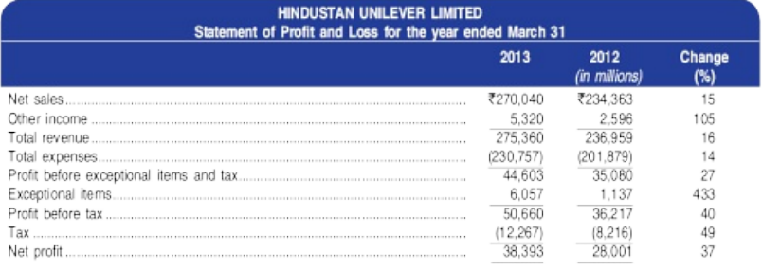
Horizontal Analysis

Slide 5
Vertical Analysis
Also known as “Common-size statements”
It is the proportional expression of the amount of each item on a financial statement to the statement total
The items within each statement are expressed in percentages of some common number and always add up to 100
Conventional to express items in the statement of profit and loss as percentages of sales, and balance sheet items as percentages of the total of shareholders’ equity and liabilities (or as percentages of total assets)
Helps in making comparisons of companies that differ in size since the financial statements are expressed in comparable common-size format

Slide 6
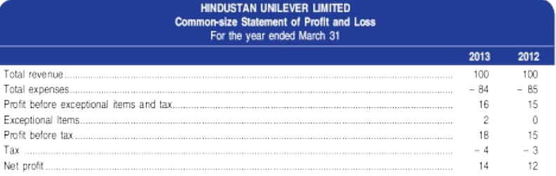
Vertical Analysis

Slide 7
THANKS

